Slide 1
Lecture.No.15
Mathematical Induction for Divisibility
DIVISIBILITY:
Let n and d be integers and d ≠ 0. Then n is divisible by d or d divides n
written as d | n. iff n = d·k for some integer k.
Alternatively, we say that
n is a multiple of d
d is a divisor of n
d is a factor of n
Thus d|n ⇔ ∃ an integer k such that n = d·k

Slide 2
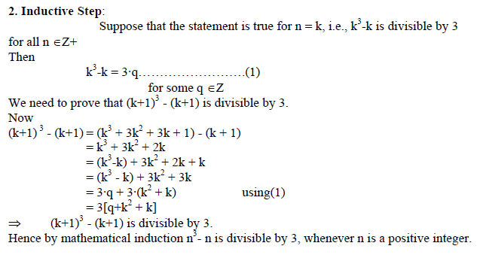
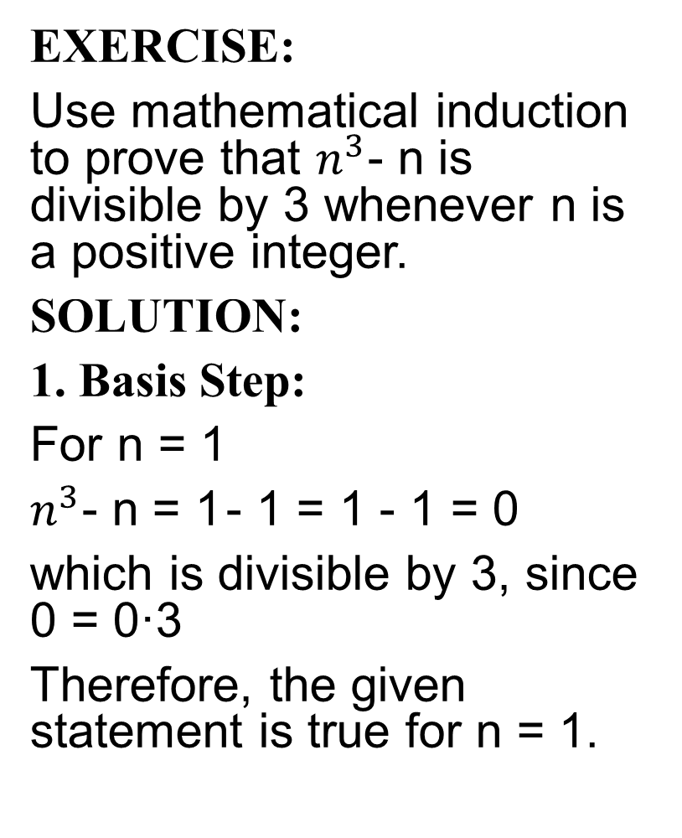
EXERCISE:
Use mathematical induction to prove that $n^{3}$- n is divisible by 3 whenever n is a positive integer.
SOLUTION:
1. Basis Step:
For n = 1
$n^{3}$- n = 1- 1 = 1 - 1 = 0
which is divisible by 3, since 0 = 0·3
Therefore, the given statement is true for n = 1.

Slide 3
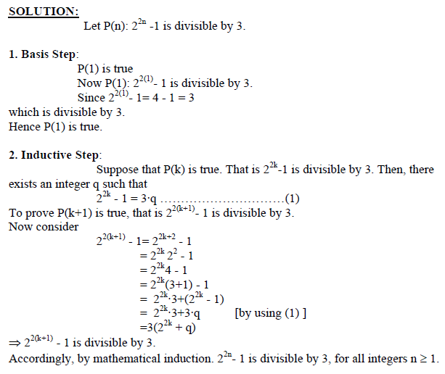
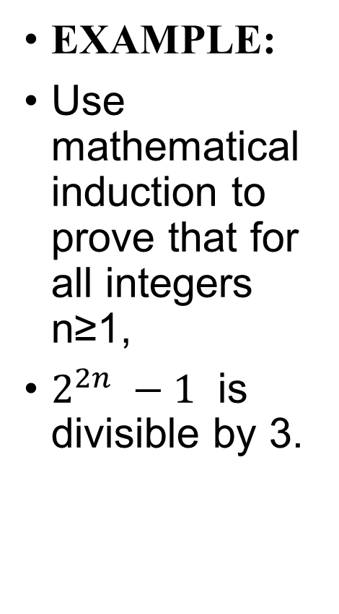
EXAMPLE:
Use mathematical induction to prove that for all integers n≥1,
$2^{2n} −1$is divisible by 3.

Slide 4
EXERCISE:
Use mathematical induction to show that the product of any two consecutive positive integers is divisible by 2.
SOLUTION:
Let n and n + 1 be two consecutive integers. We need to prove that n(n+1) is divisible by 2.
1. Basis Step:
For n = 1
n (n+1) = 1·(1+1) = 1·2 = 2, which is divisible by 2.
2. Inductive Step:
Suppose the given statement is true for n = k. That is
k (k+1) is divisible by 2, for some k ∈ Z+
Then k (k+1) = 2·q ………………….(1) q ∈ Z+
We must show that
(k+1)(k+1+1) is divisible by 2.
Consider (k+1)(k+1+1) = (k+1)(k+2)
= (k+1)k + (k+1)2
= 2q + 2 (k+1) using (1)
= 2(q+k+1)
Hence (k+1) (k+1+1) is also divisible by 2.
Accordingly, by mathematical induction, the product of any two consecutive positive
integers is divisible by 2

Slide 5
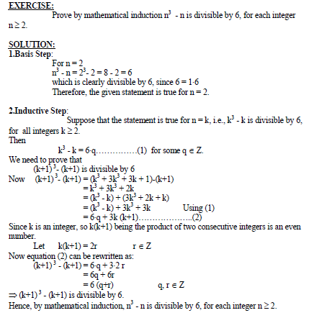

Slide 6
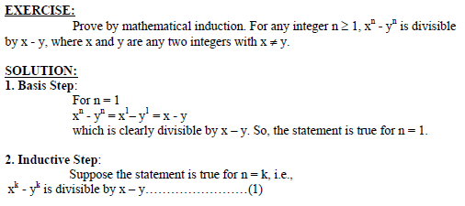
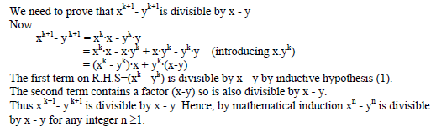

Slide 7
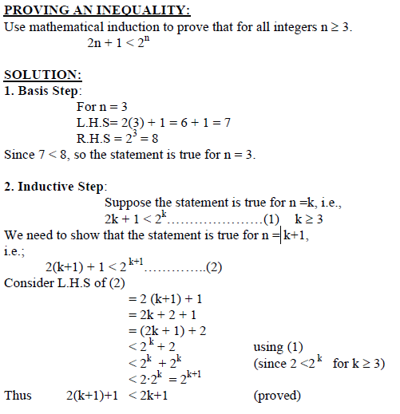

Slide 8
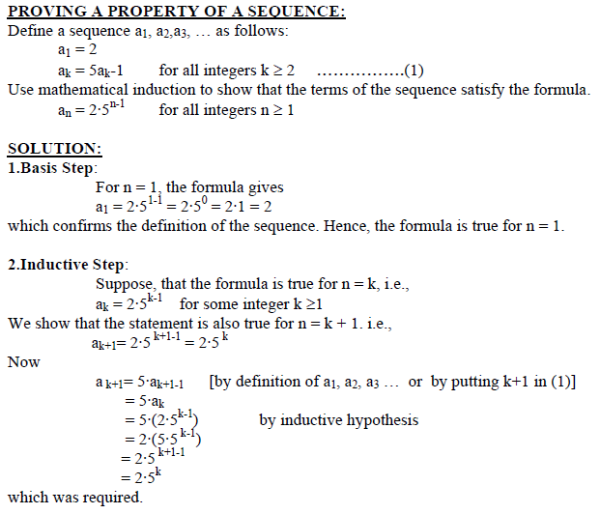

Slide 9

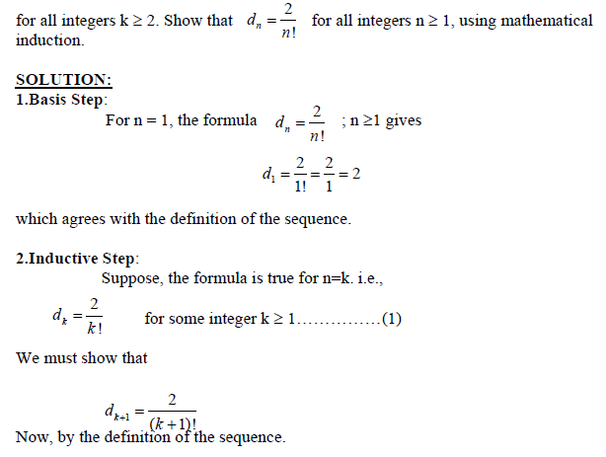

Slide 10
